Slide 1
Scientists created a new system of classification by studying different characteristics of different organisms.
Major different characteristics created
Broader groups
Plants
Animals
Lesser different characteristics makes smaller groups
More similar characteristics make more smaller sub groups.

Slide 2
This is called ‘Hierarchy’.
Totally different characteristics
Lesser different characteristics
Similar characteristics
Very similar characteristics
Characteristics of organisms

Slide 3


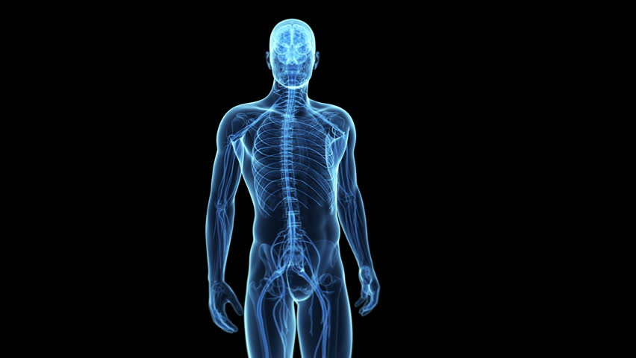
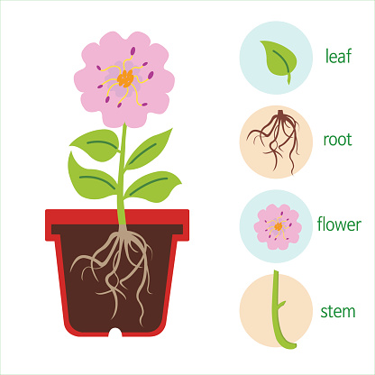
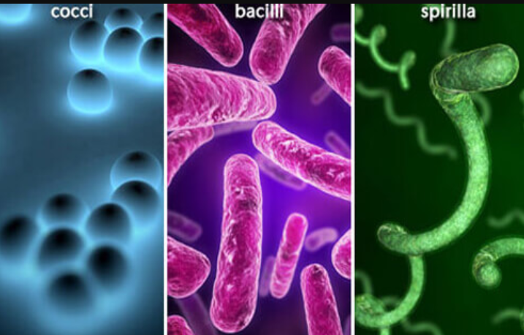
CLASSIFICATION AND EVOLUTION
All living things are IDENTIFIED AND CATEGORIZED on the basis of their BODY DESIGN in form and function.

Slide 4

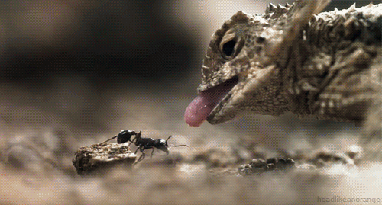
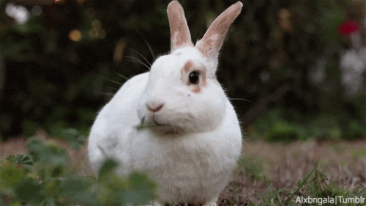
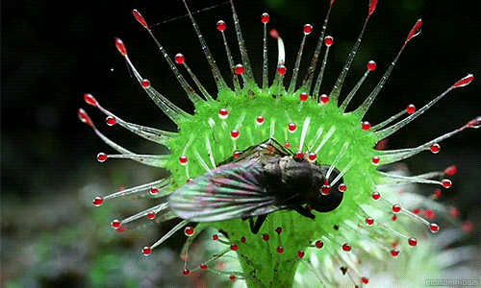
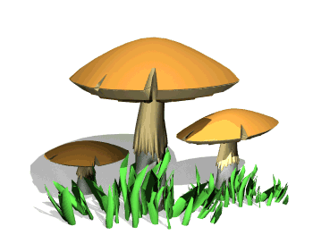
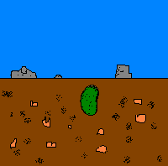
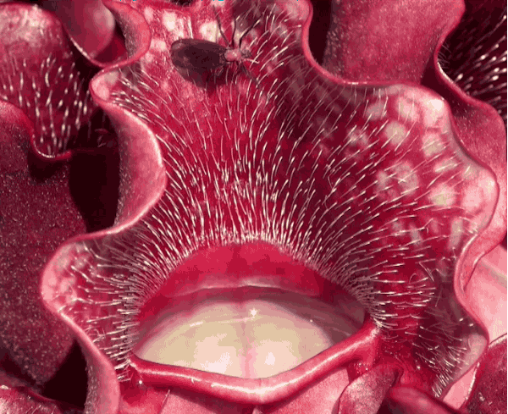
CLASSIFICATION AND EVOLUTION
Some CHARACTERISTICS are likely to make more
WIDE-RANGING CHANGES IN BODY DESIGN than others.

Slide 5
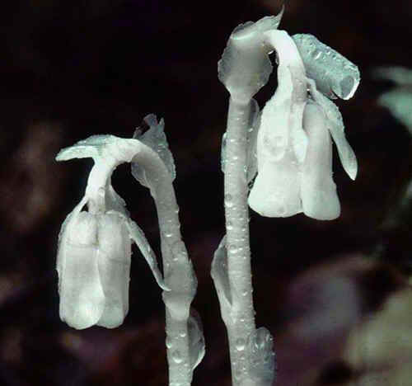
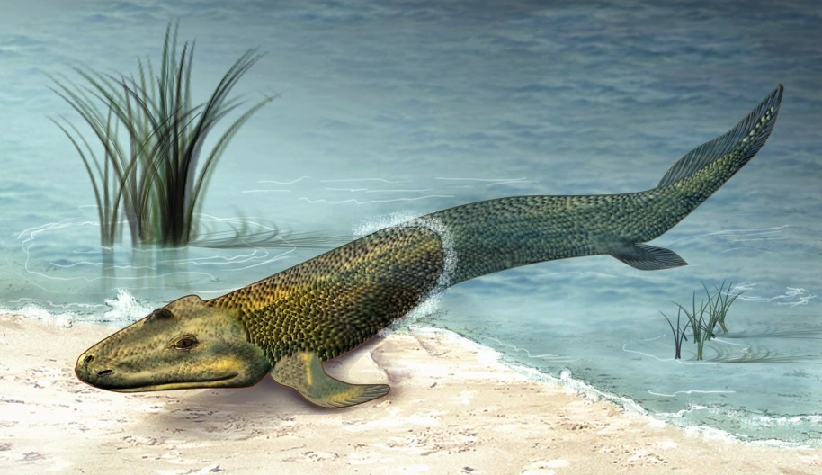
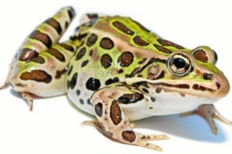
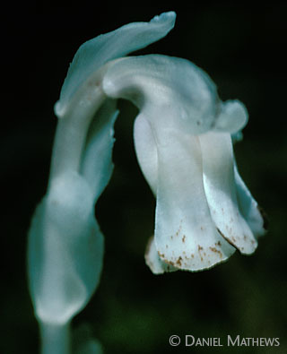

CLASSIFICATION AND EVOLUTION
There is a ROLE OF TIME in this as well.

Slide 6
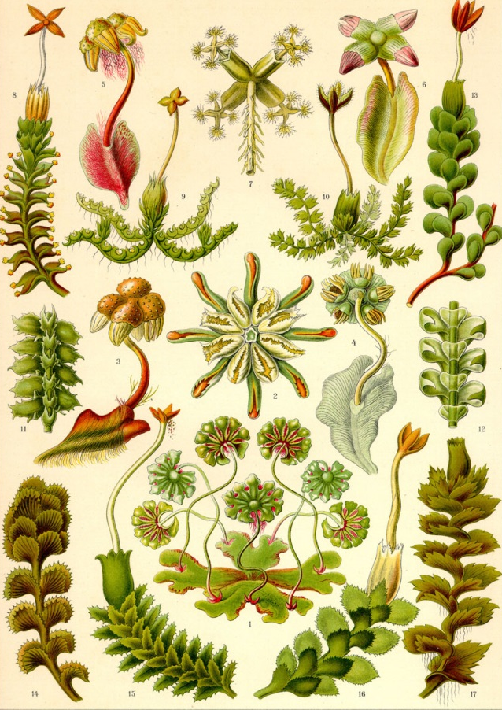
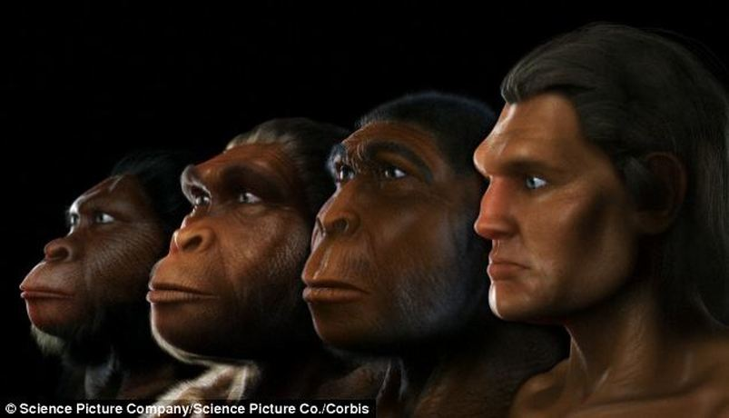
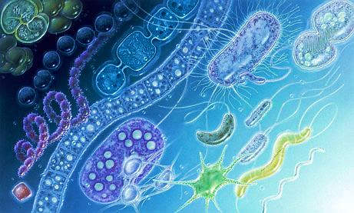
CLASSIFICATION AND EVOLUTION
So, once a certain body design comes into existence, it will SHAPE THE EFFECTS
Of All Other Subsequent Design Changes, simply because it already exists.

Slide 7
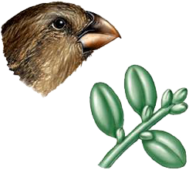
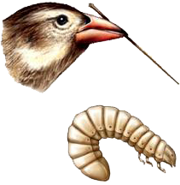
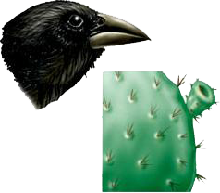
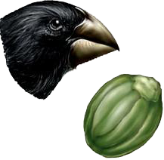
CLASSIFICATION AND EVOLUTION
Characteristics That Came Into Existence Earlier Are Likely To Be More Basic THAN characteristics that have come into existence later.

Slide 8
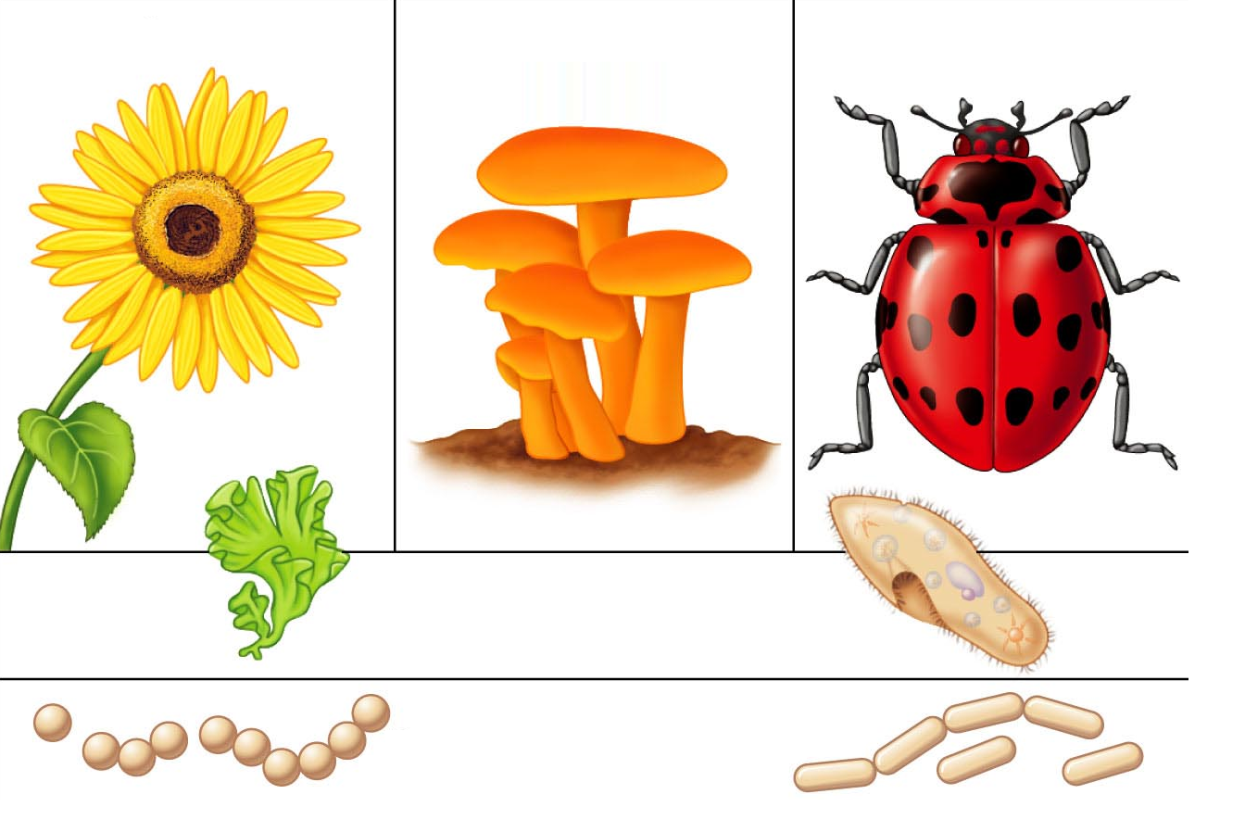
CLASSIFICATION AND EVOLUTION
This means that the Classification Of Life Forms Will Be Closely Related To Their Evolution.

Slide 9
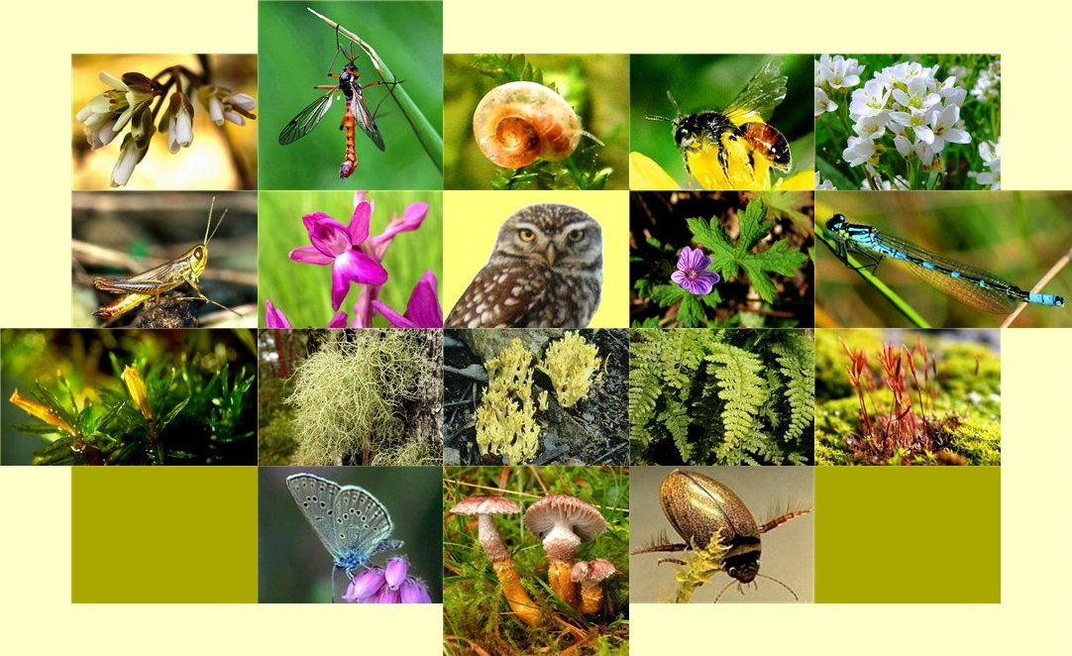
CLASSIFICATION AND EVOLUTION
Most life forms that we see today have arisen by An Accumulation Of Changes In Body Designs.

Slide 10
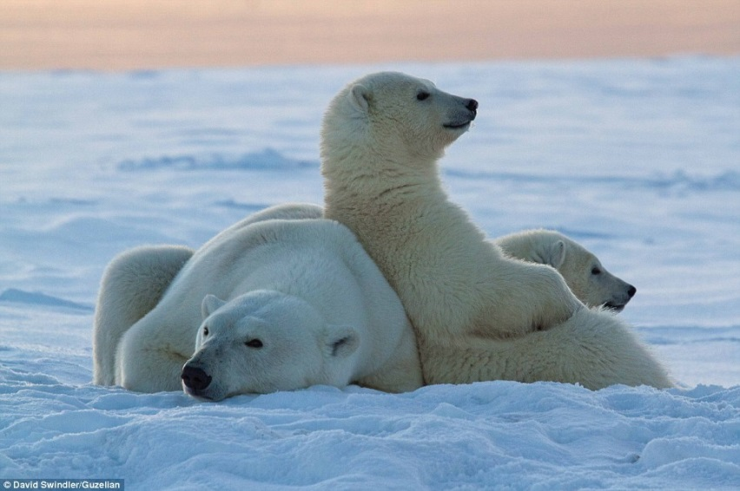
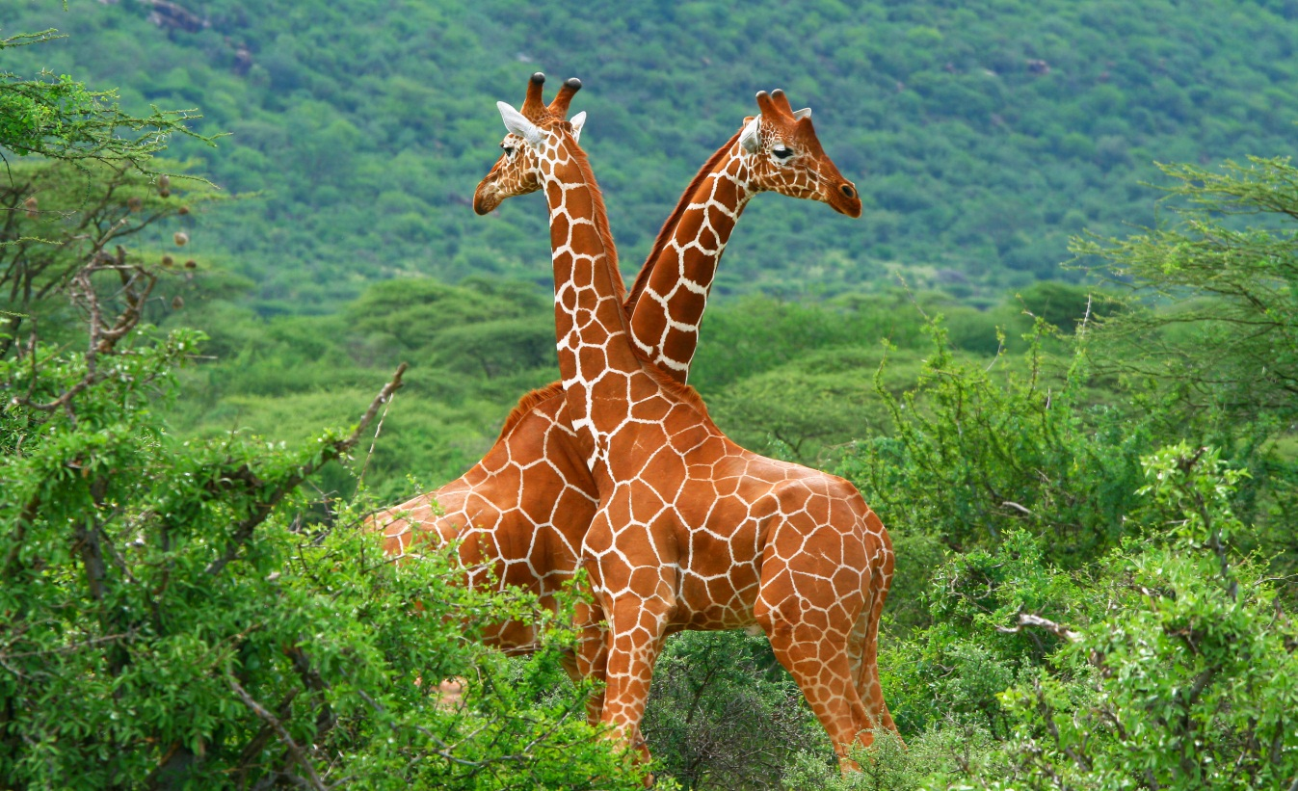
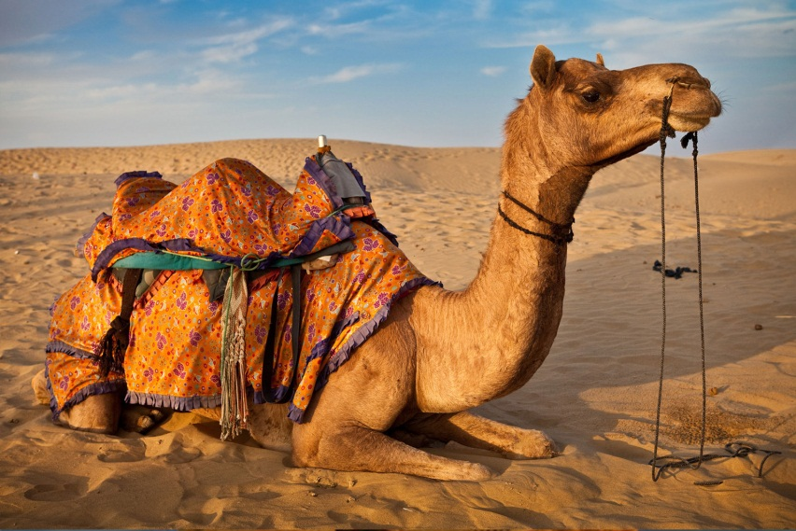
CLASSIFICATION AND EVOLUTION
These body designs Allow The Organism Possessing Them To Survive Better.

Slide 11
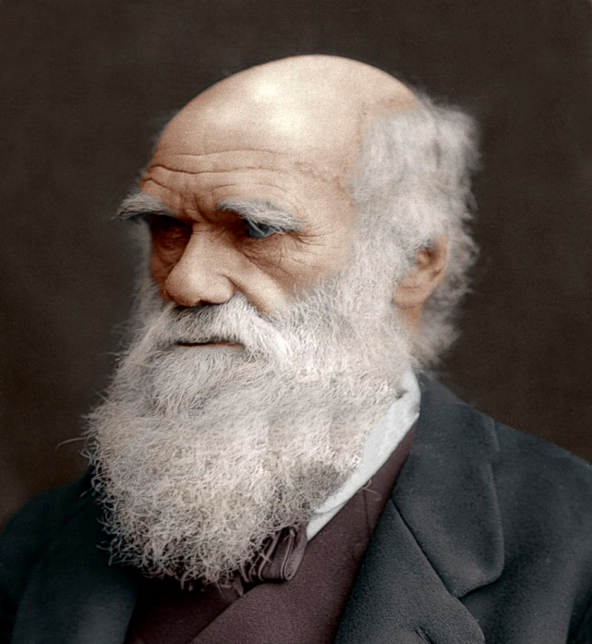
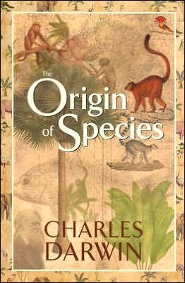
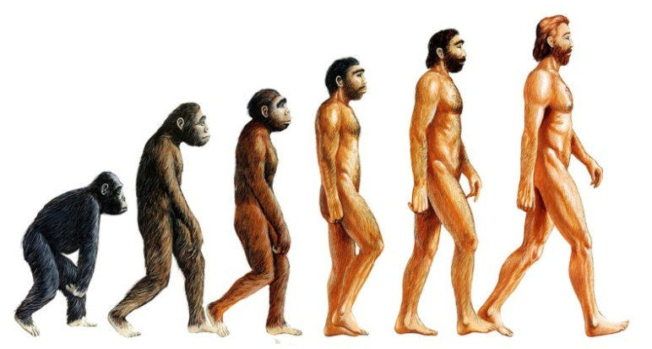
CLASSIFICATION AND EVOLUTION
CHARLES DARWIN first described this IDEA OF EVOLUTION
in 1859 in his book, The ORIGIN OF SPECIES.
Charles Robert Darwin

Slide 12
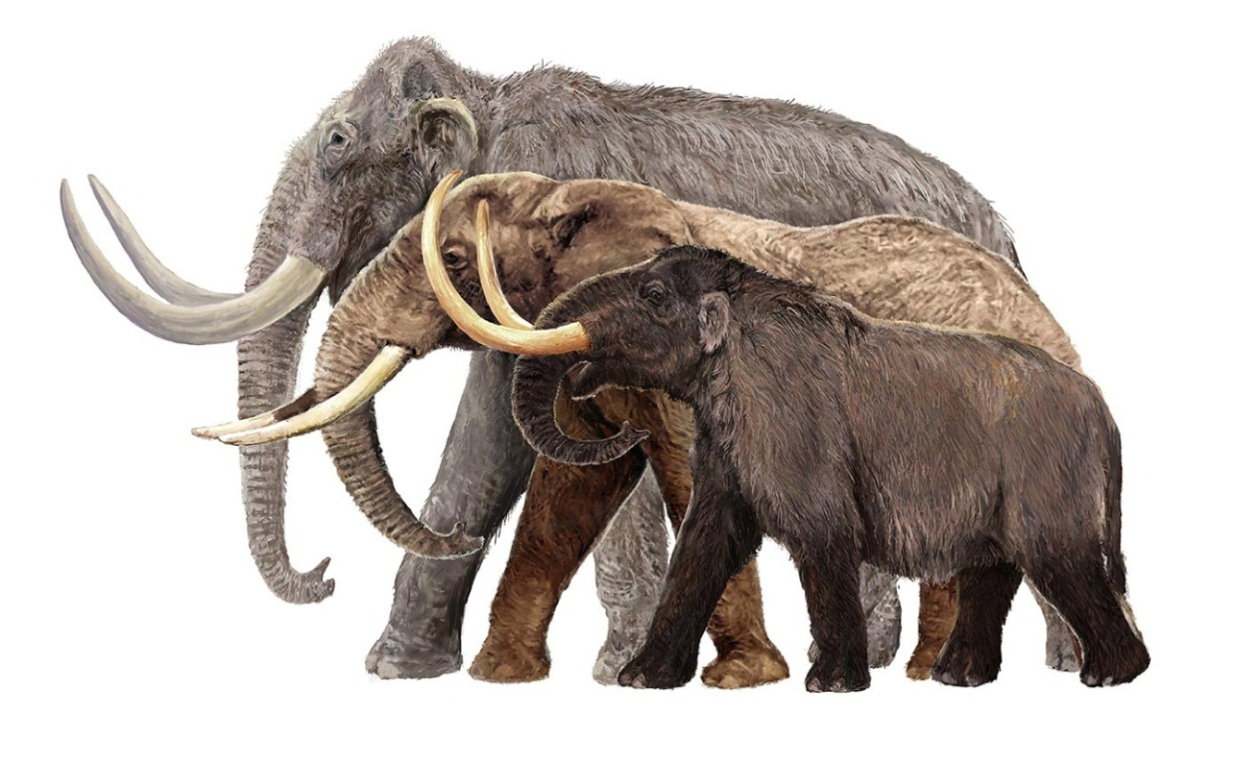
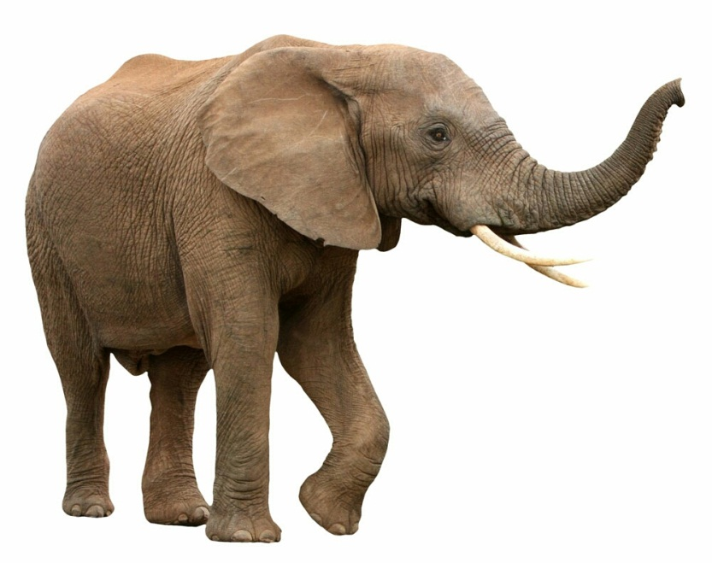
CLASSIFICATION AND EVOLUTION
When we connect this idea of evolution to classification, we will find some groups of
organisms which have ancient body designs that have not changed very much.

Slide 13


CLASSIFICATION AND EVOLUTION
We will also find Other Groups Of Organisms that
Have Acquired Their Particular Body Designs Relatively Recently.

Slide 14
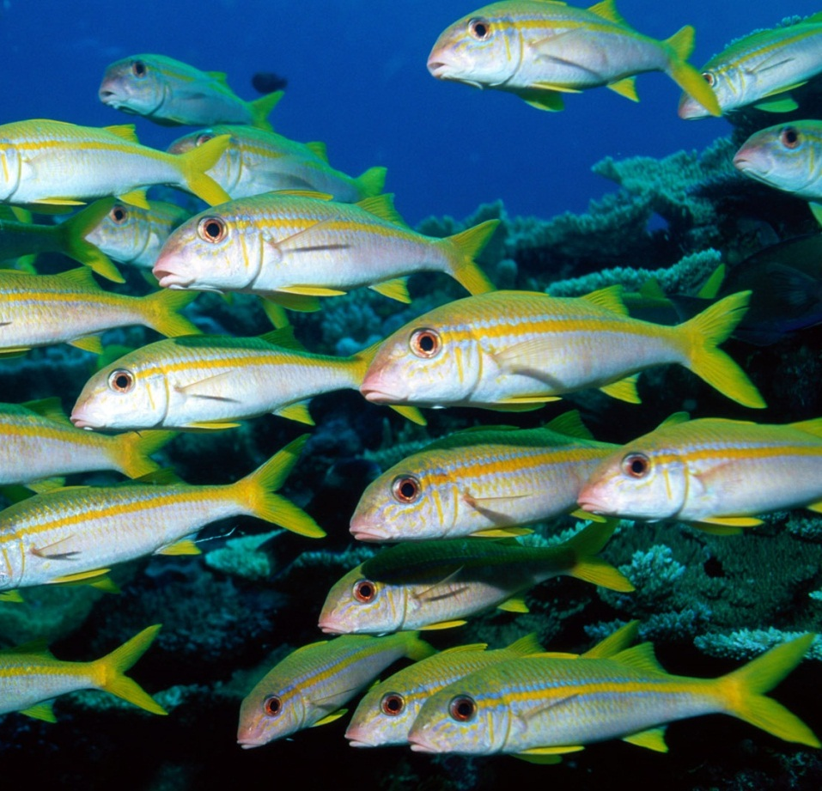
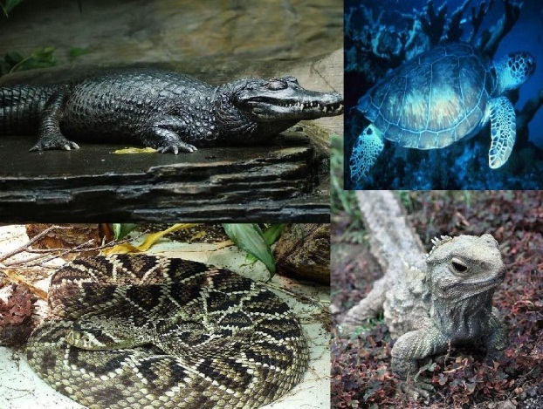
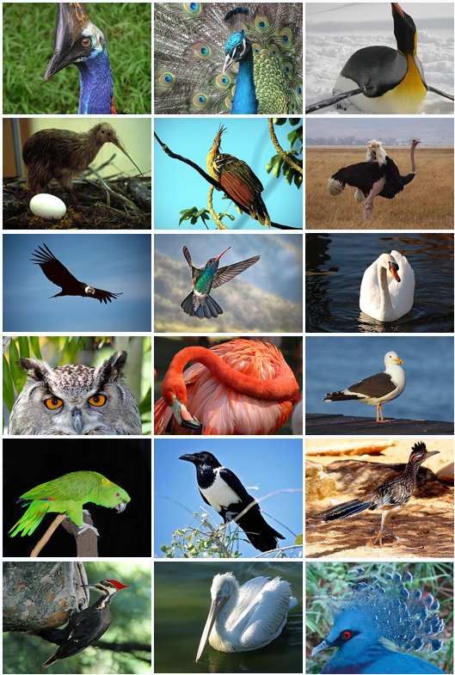
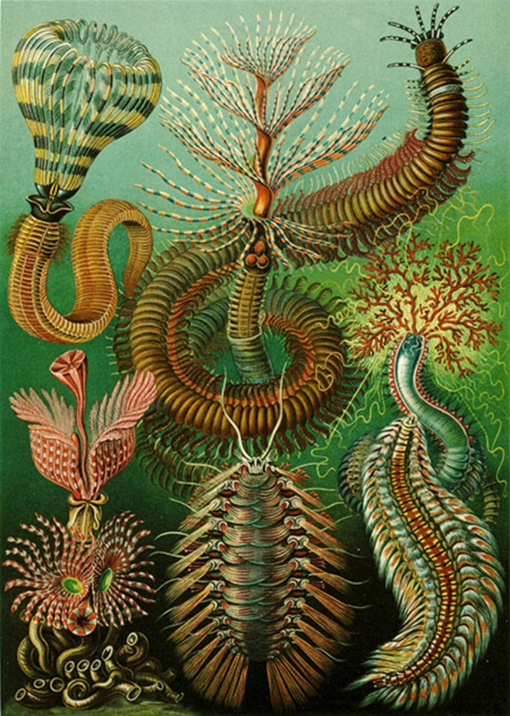
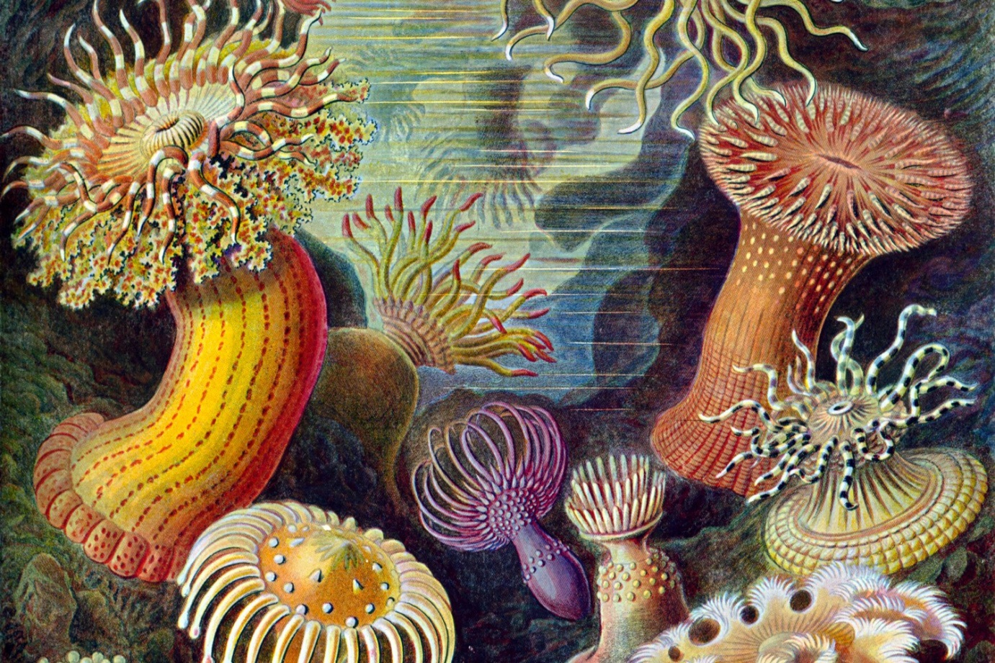
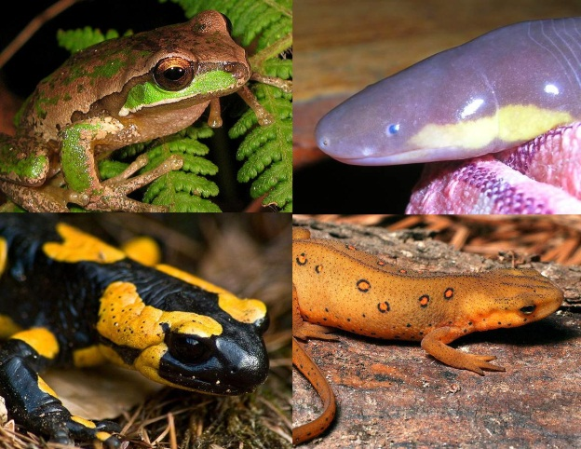
CLASSIFICATION AND EVOLUTION
Those in the first group are frequently referred to as ‘primitive’ or ‘lower’ organisms,
while those in the second group are called ‘advanced’ or ‘higher’ organisms.

Slide 15
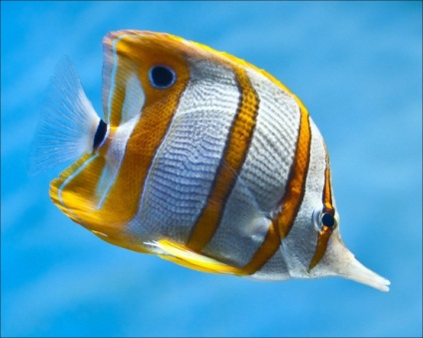
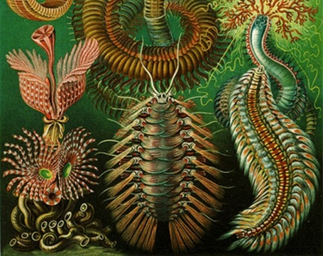
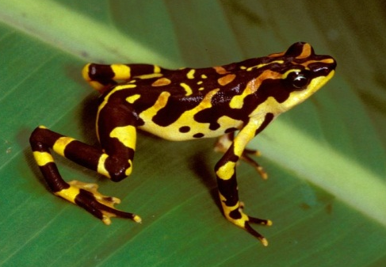
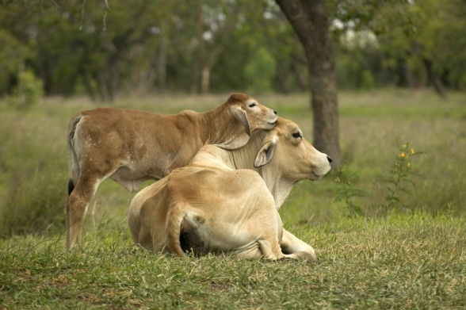
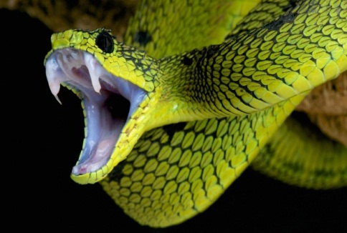
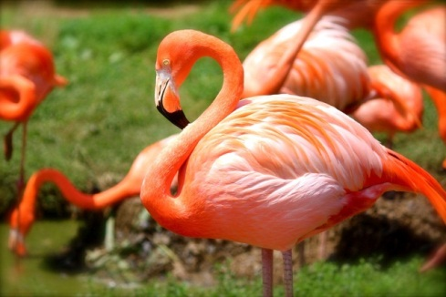
CLASSIFICATION AND EVOLUTION
We can say is that some are ‘Older’ organisms, while some are ‘Younger’ organisms.
The terms ‘primitive’ or ‘lower’ and ‘advanced’ or ‘higher’ are not quite correct since they do not properly relate to the differences.

Slide 16
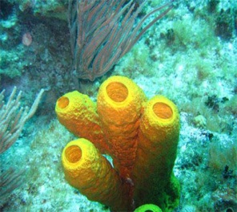
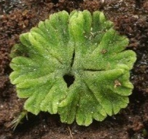

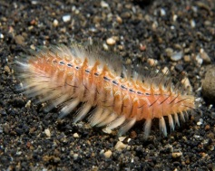
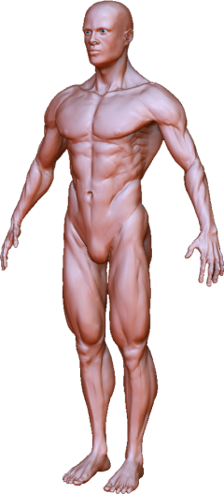
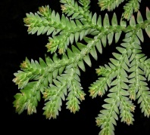
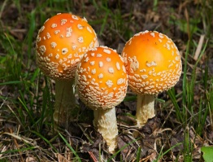
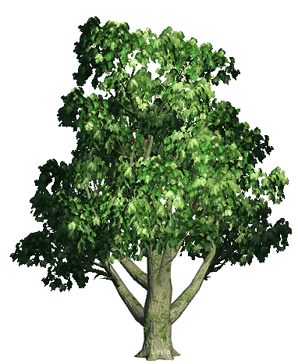

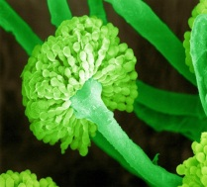





CLASSIFICATION AND EVOLUTION
It may not be wrong to say that older organisms are simpler, while younger organisms are more complex.
Time
Since there is a possibility that Complexity In Design Will Increase Over Evolutionary Time,
Complexity In Design

